Slide 1
A&T STREAMLINED PARKING
Addison Shaver and Tom Cerulli

Slide 2
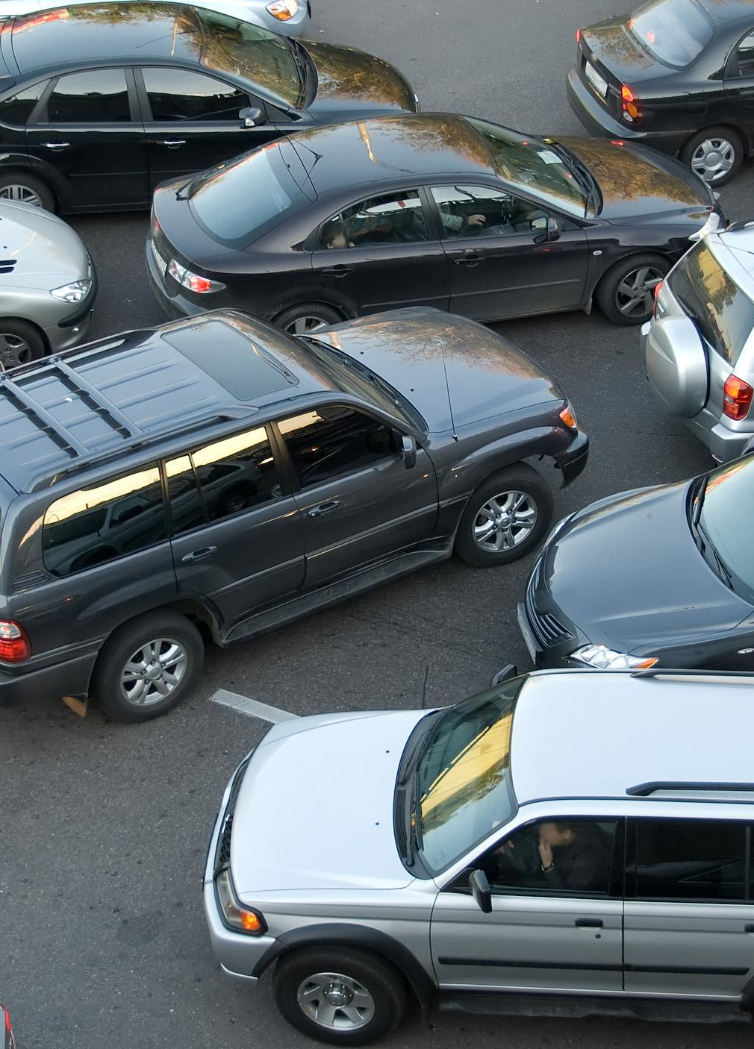
SOLVING CROWDED PARKING
Parking ecosystem that allows:
Easy parking
Zero parking mistakes
Quick finding of parking spots
Notes:
Streamlines parking by directing drivers where to park based upon arrival time and location (determined by phone gps). For example, if one car is nearer to a parking space than another, the system automatically directs other drivers to different spaces based upon proximity.

Slide 3
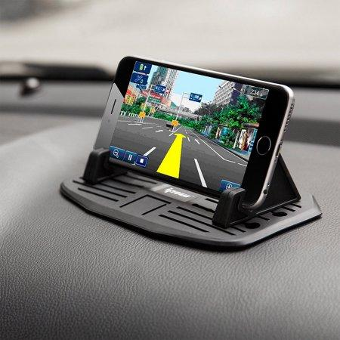
HOW IT WORKS
Car detection using an array of surveillance cameras
Unique identifiers based on licence plates
Notes:
The system works by using an array of cameras to detect cars and their license plates in a designated parking area, keeping track how full a lot is, who is in it, and how could its traffic could affect drivers who are trying to enter it.

Slide 4
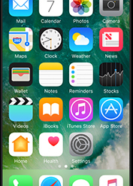
PHONE APP
Directions for finding your spot
Ties into google maps for directions and forewarning about parking delays.
Augmented reality using companion app
Notes:
The companion app is integral to the streamlined parking system, as it uses the information gathered from the system sensors to direct drivers to available spaces. It also takes note of where specific drivers are parked, so that if you forgot where you parked your car for the day, the app could give directions for getting to your car. When giving directions on where to drive, we have toyed with the notion that we could leverage the phone’s camera so as to overlay an arrow path in the vehicle should move in real time.

Slide 5

REVENUE
Automates ticketing
Timed parking spaces
Can share expected loads at any time for expected foot traffic
Notes:
Since all vehicles are being tracked through the streamlined system, it would easy to figure out if a vehicle is parked illegally, or not in the system, which in turn could indicate if it is a visitor or not. The system would also give the option of timed parking spaces in high demand areas, which could cost certain amounts to park in, creating a reoccurring revenue stream as well as leaving some high demand areas more available for parking.
Another big bonus of the system is that it could help predict foot traffic in certain areas based upon arriving drivers, which could be given to the Aggie Shuttle service so the drivers could know what to expect at any given time.

Slide 6

ANALYTICS
Improve speed and efficiency of campus services
Traffic prediction
Direct traffic
Emergency vehicles
Notes:
Like mentioned before, the system generates a lot

